Slide 1
Macomb Beautiful Association
Beautification Awards Reception
September 19, 2024
Macomb Art Center

Slide 2
2024 Beautification Winners
Residential Winners
  Cindy Amundsen, 604 Beverly Avenue
  Eric and Kathy Lenardt, 126 N. Ward
  Tim and Alice Moss, 414 S. Lafayette
  Mark and Amy Mossman, 720 Jamie Lane
  Tom and Karen Schneider, 1407 Stacy Lane
Business Winners
  Lexington/Concord Apartments, 902 N. Charles
  Moore Tires, 1103 E. Jackson
  Margaret Stover Service Award
  Miriam Satern

Slide 3
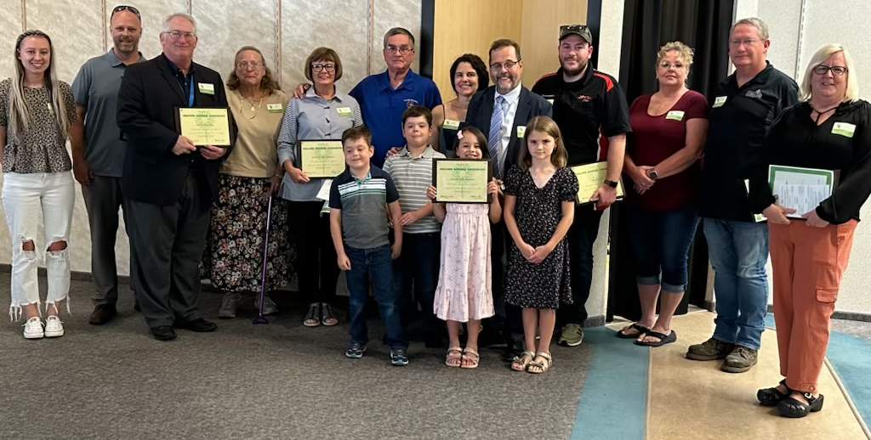
2024 MBA Beautification Award Winners

Slide 4
604 Beverly Avenue
Cindy Amundsen

Slide 5
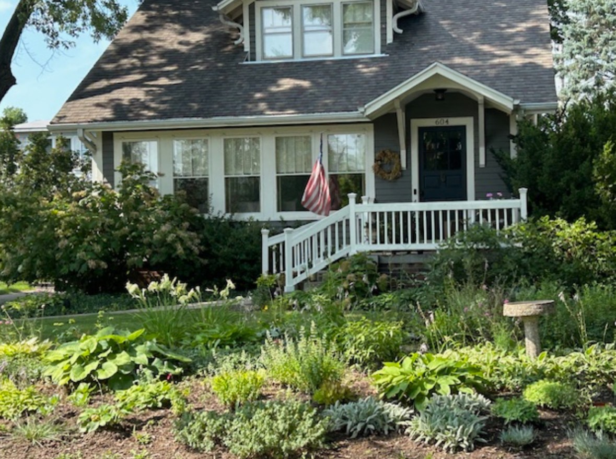

Slide 6
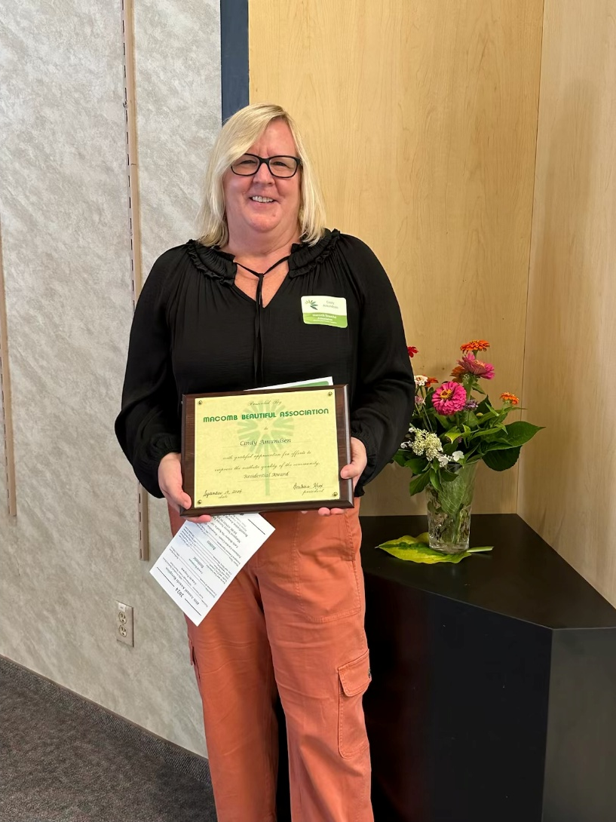

Slide 7
  126 N. Ward
Eric and Kathy Lenardt

Slide 8
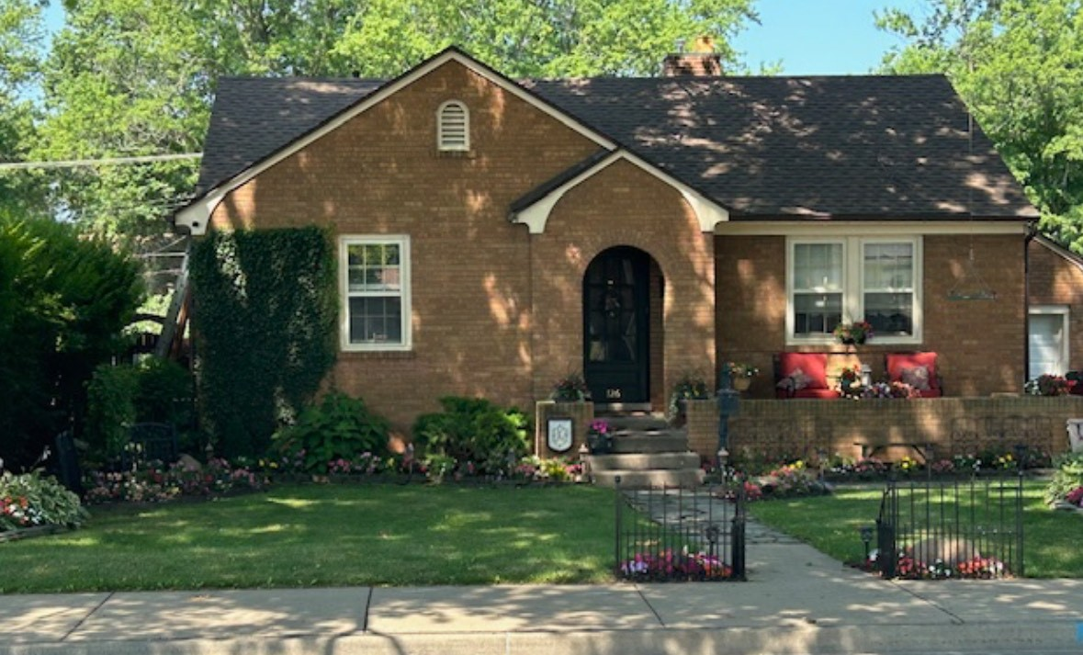

Slide 9
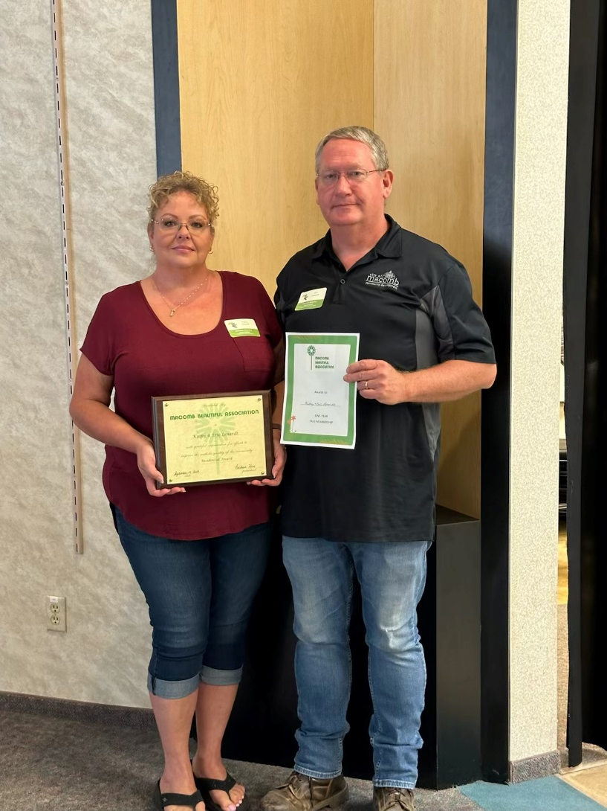

Slide 10
  414 S. Lafayette
Tim and Alice Moss

Slide 11
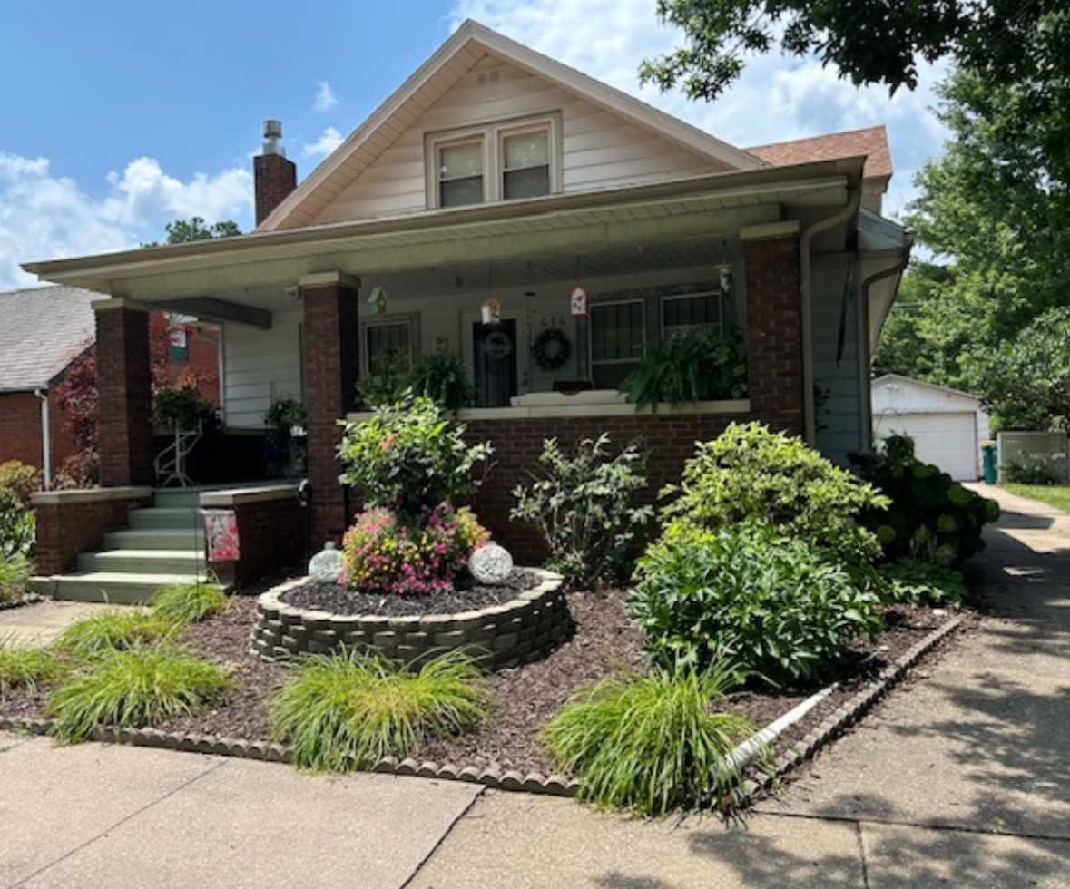

Slide 12
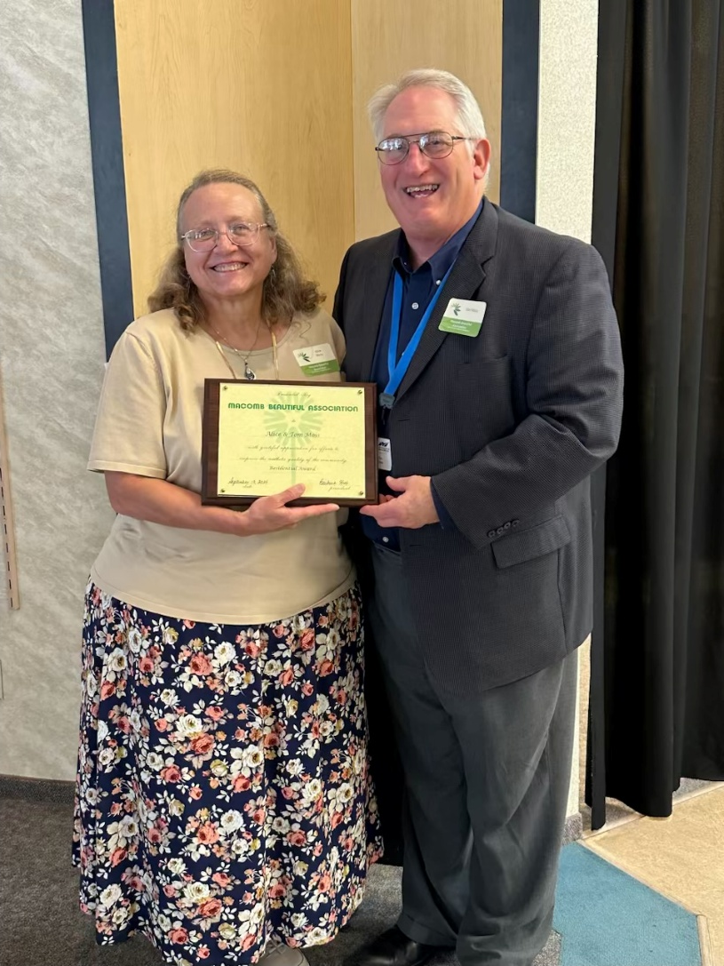

Slide 13
720 Jamie Lane
Mark and Amy Mossman

Slide 14
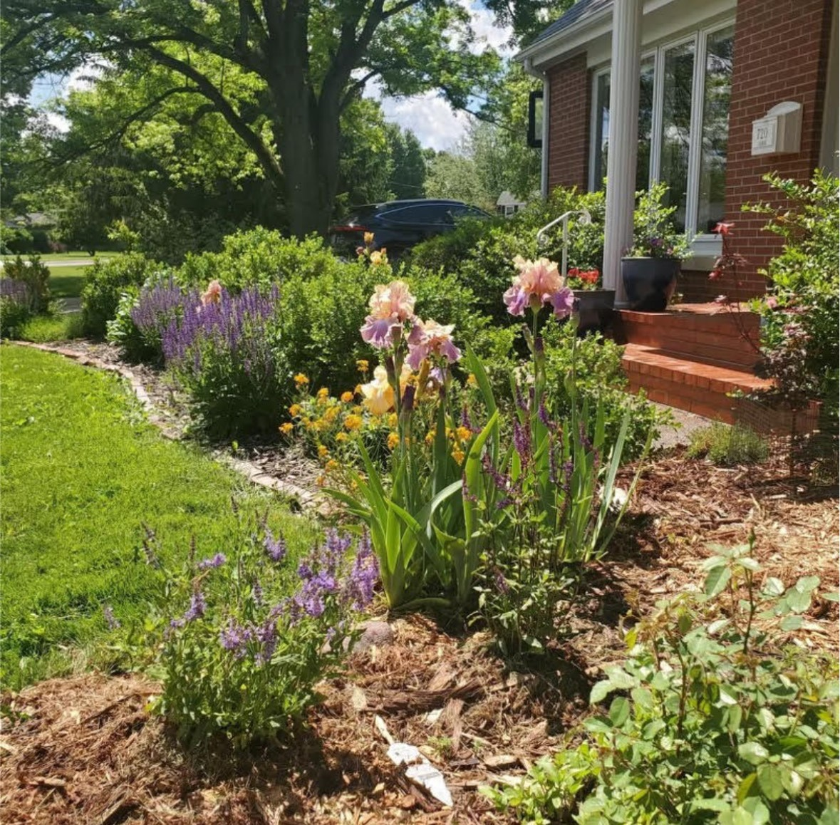

Slide 15
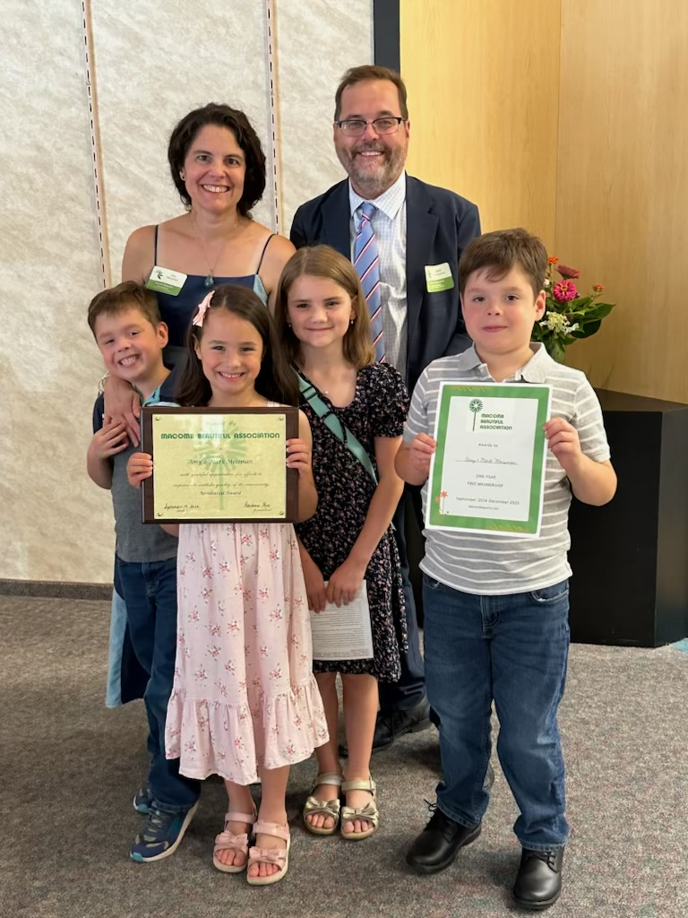

Slide 16
1407 Stacy Lane
Tom and Karen Schneider

Slide 17
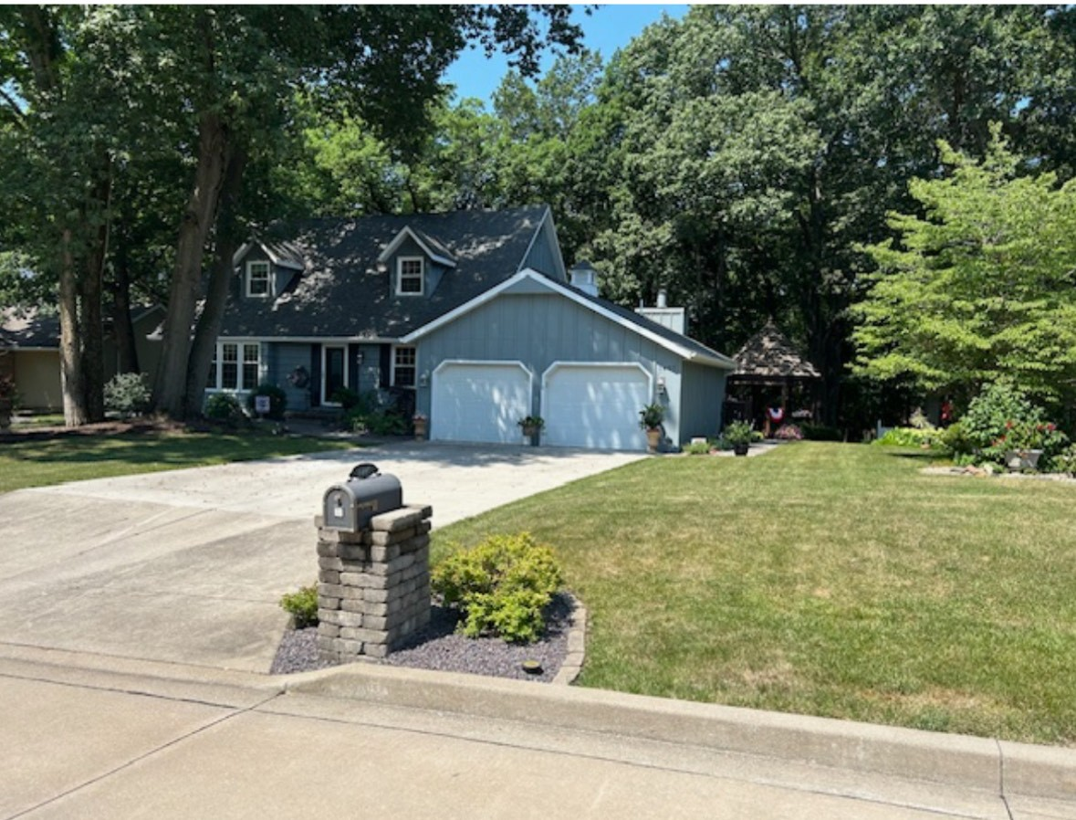

Slide 18
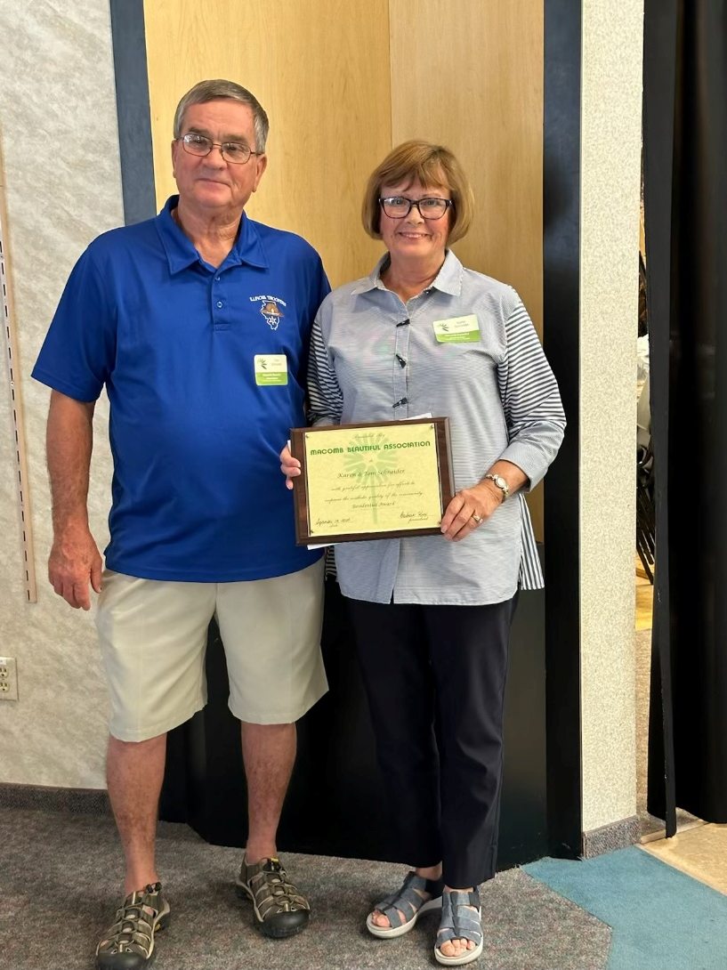

Slide 19
Moore Tires
1103 E. Jackson
Ted Robbins
Store Manager

Slide 20
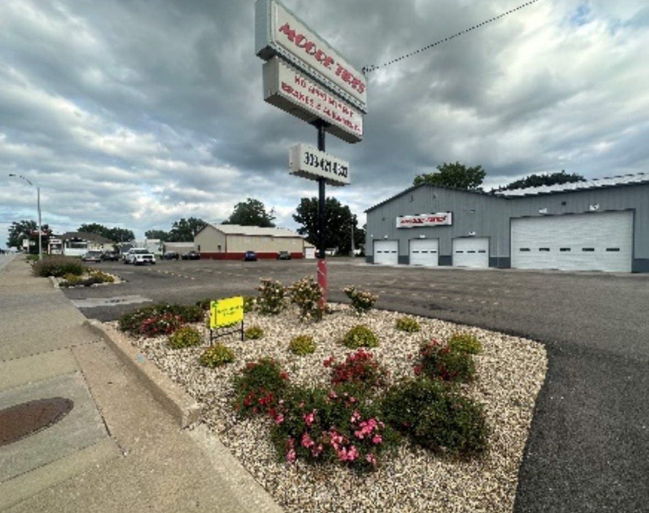

Slide 21
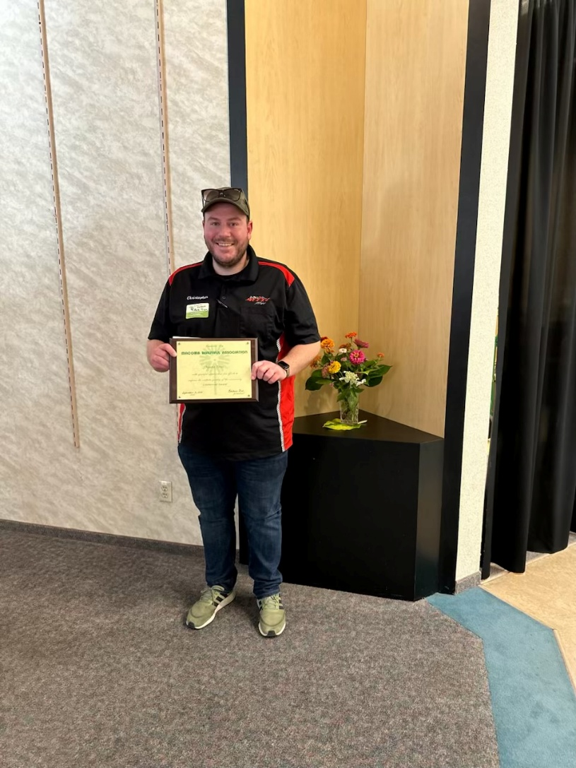

Slide 22
Lexington Concord Apartments
902 N. Charles
James Fowler
General Manager

Slide 23
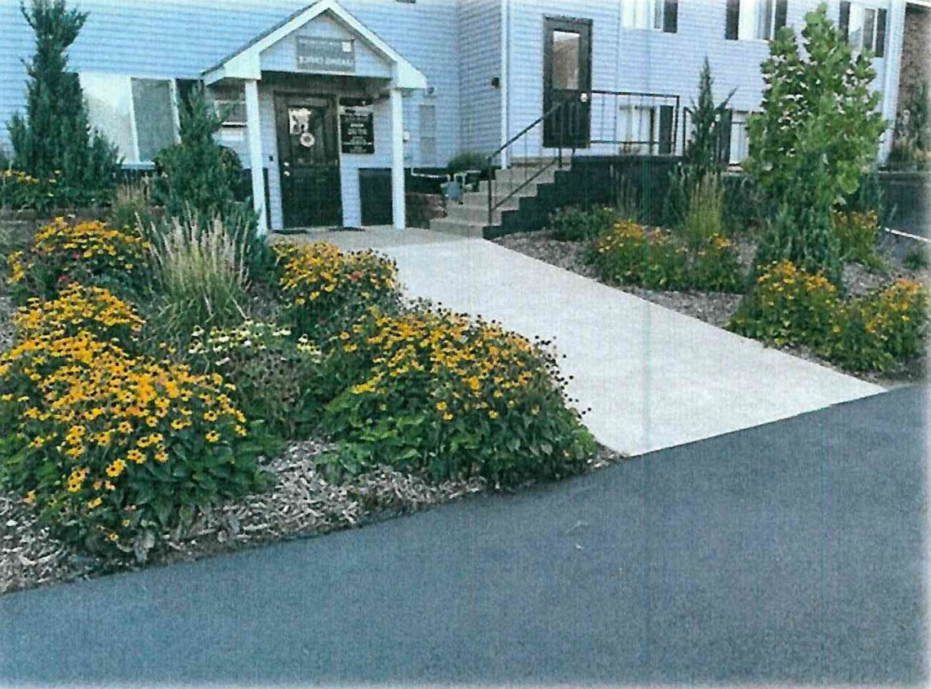

Slide 24
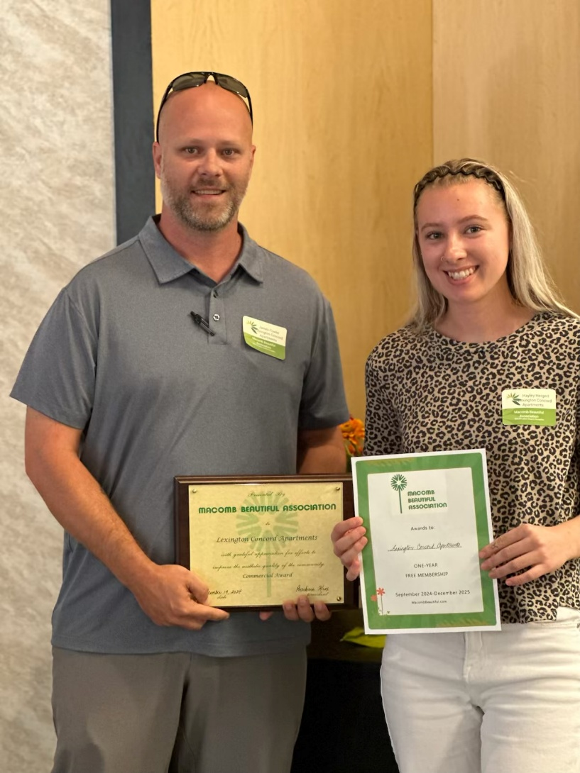

Slide 25
CONGRATULATIONS
TO ALL THE 2024
BEAUTIFICATION AWARD RECIPIENTS

Slide 26
Macomb Beautiful Association
Margaret Stover Service Award

Slide 27
CONGRATULATIONS
Margaret Stover Service Award Winner
Miriam Satern

Slide 28
