Slide 1
Macomb Beautiful Association
Beautification Awards Reception
September 22, 2022
Macomb Art Center

Slide 2
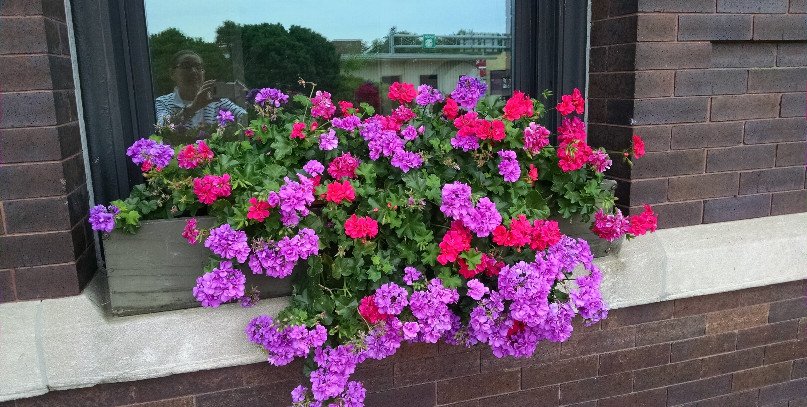
MBA Plantings at the Train Depot

Slide 3
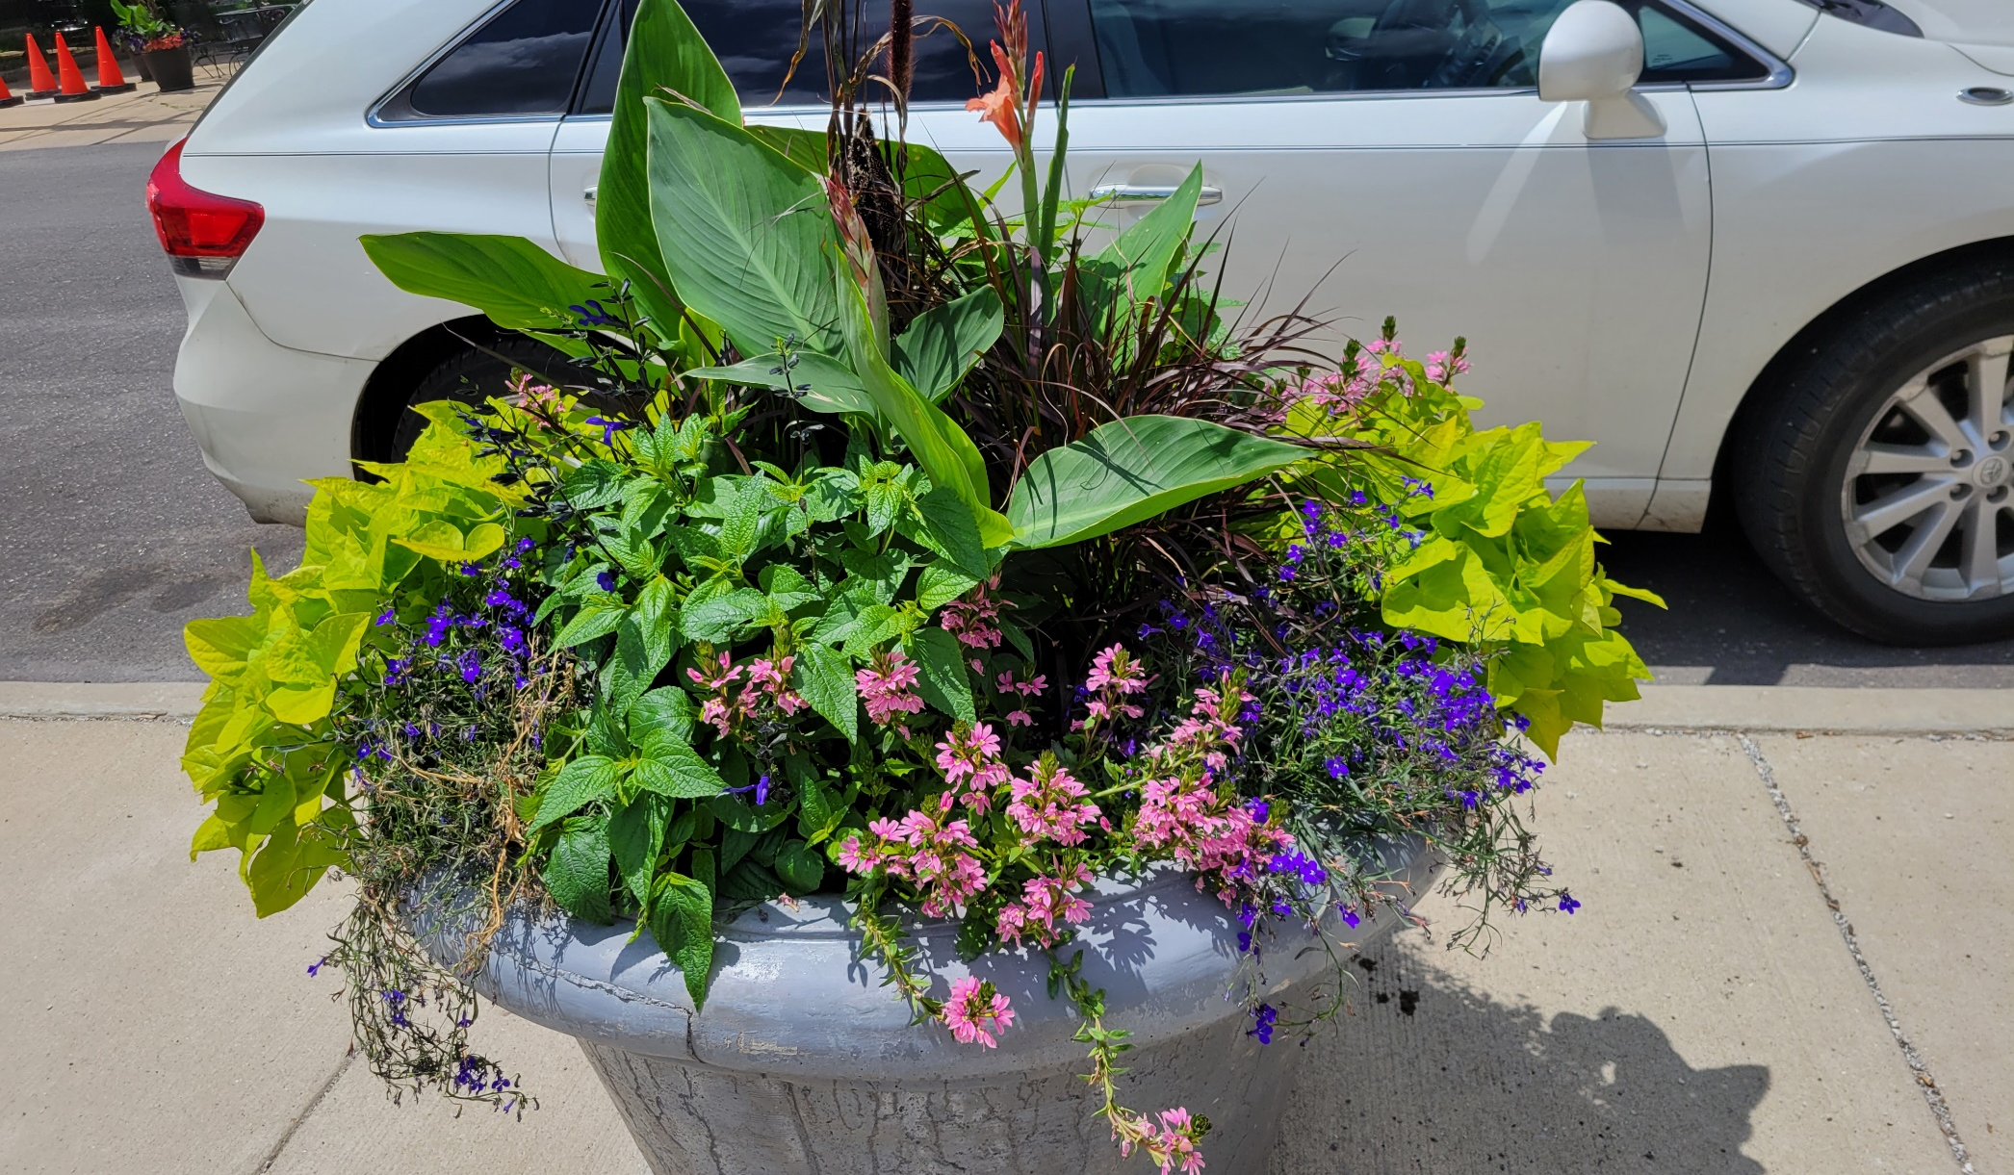
Large Planter on S. Lafayette

Slide 4
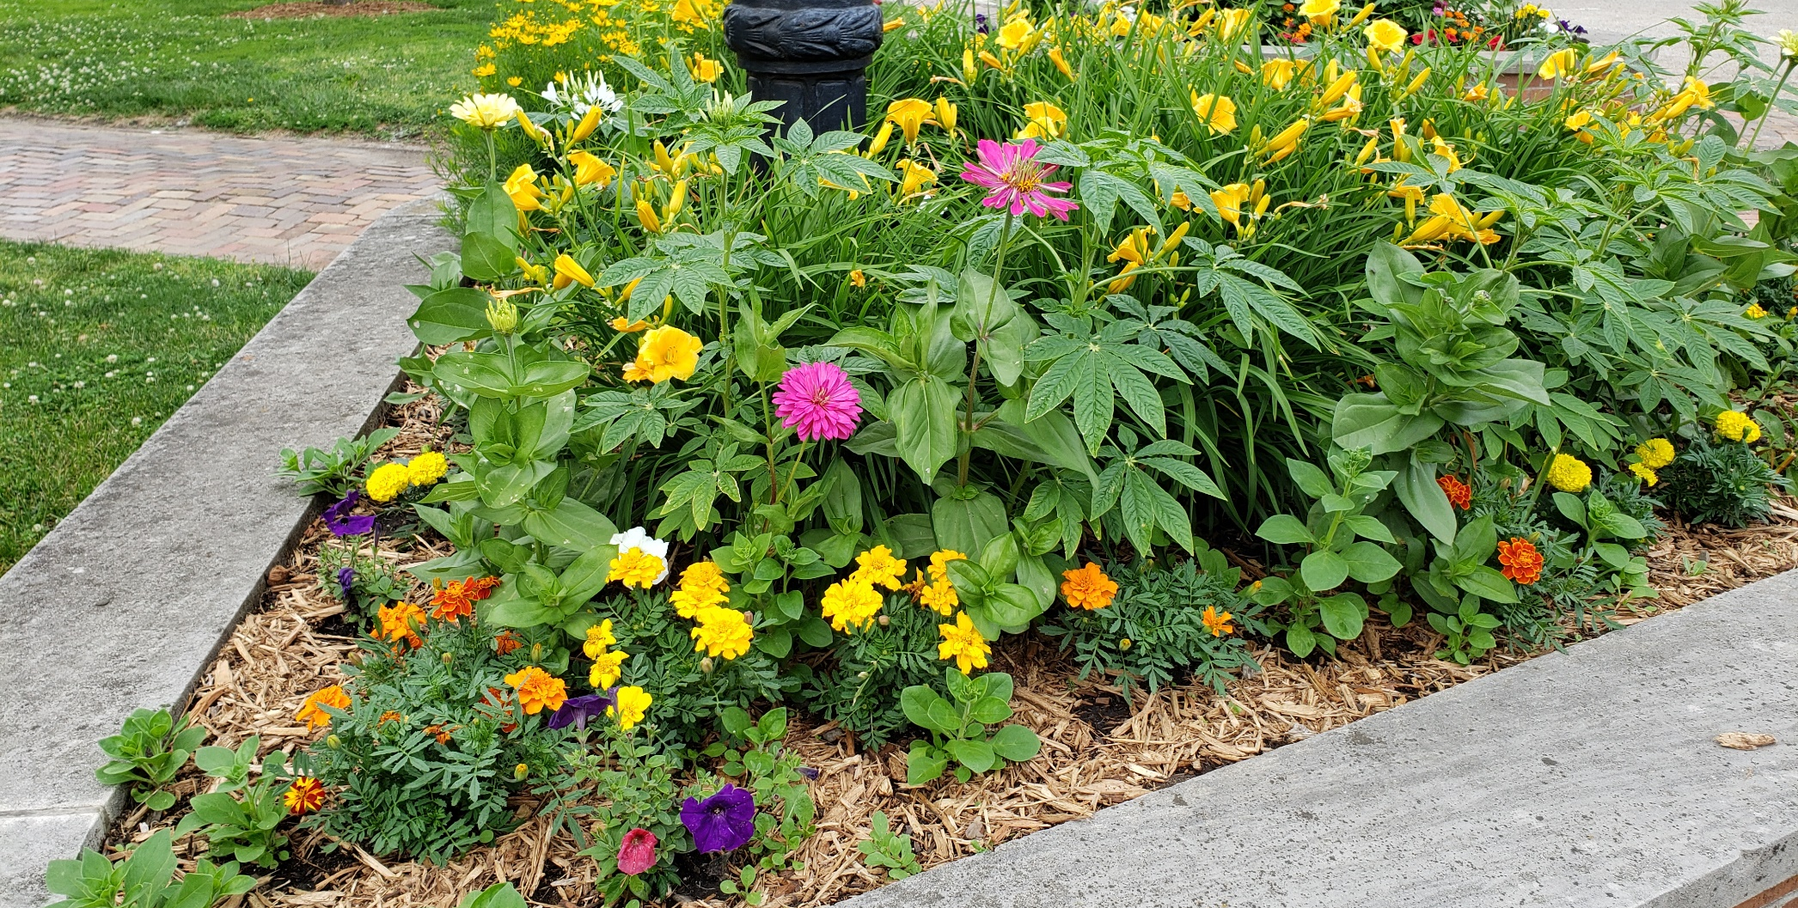
MBA Plantings – Corner of Chandler Park

Slide 5
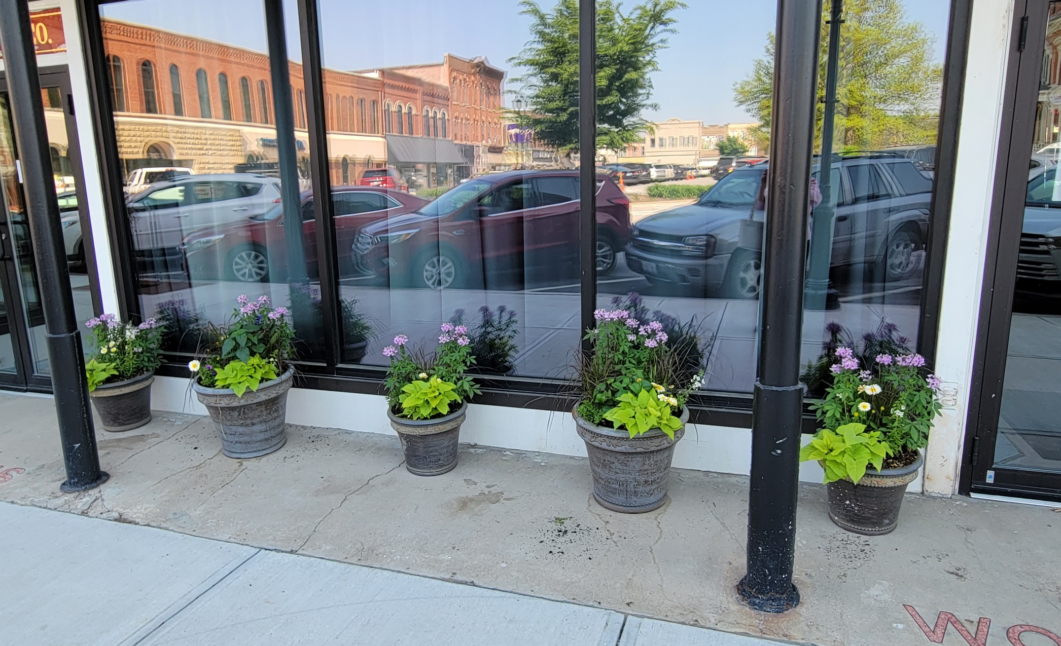
MBA Plantings - Macomb Art Center

Slide 6
2022 Beautification Winners
Residential Winners
  Lorrie and Robert Chaplin, 628 Memorial Drive
  Liz and Tyler Hardisty, 830 Glenoak Drive
  Bobbi Morrison, 227 E. Yeiser Street
  Bonita Rector, 307 Scotch Pine Drive
  Dwaine and Jo Ella Roche, 1020 Hawthorne Ridge
Business Winner
  Everly House, 811 S. Lafayette St., Faith Campbell, Administrator
  Chubby’s, 2 West Side Square, Tammy Yates and Chad Huncyker

Slide 7
628 Memorial Drive
Lorrie and Robert Chaplin

Slide 8
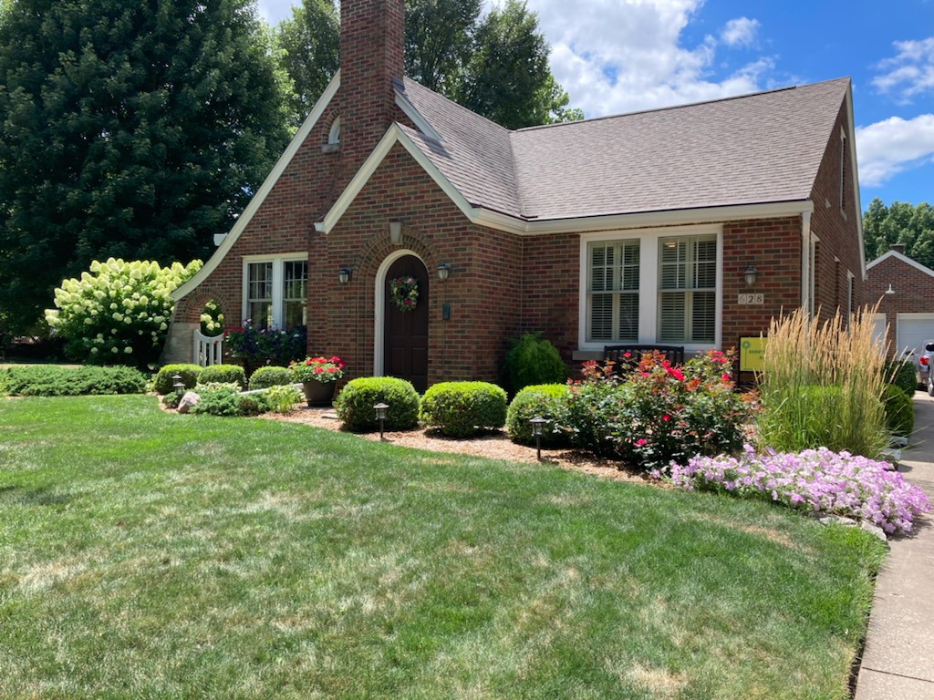

Slide 9
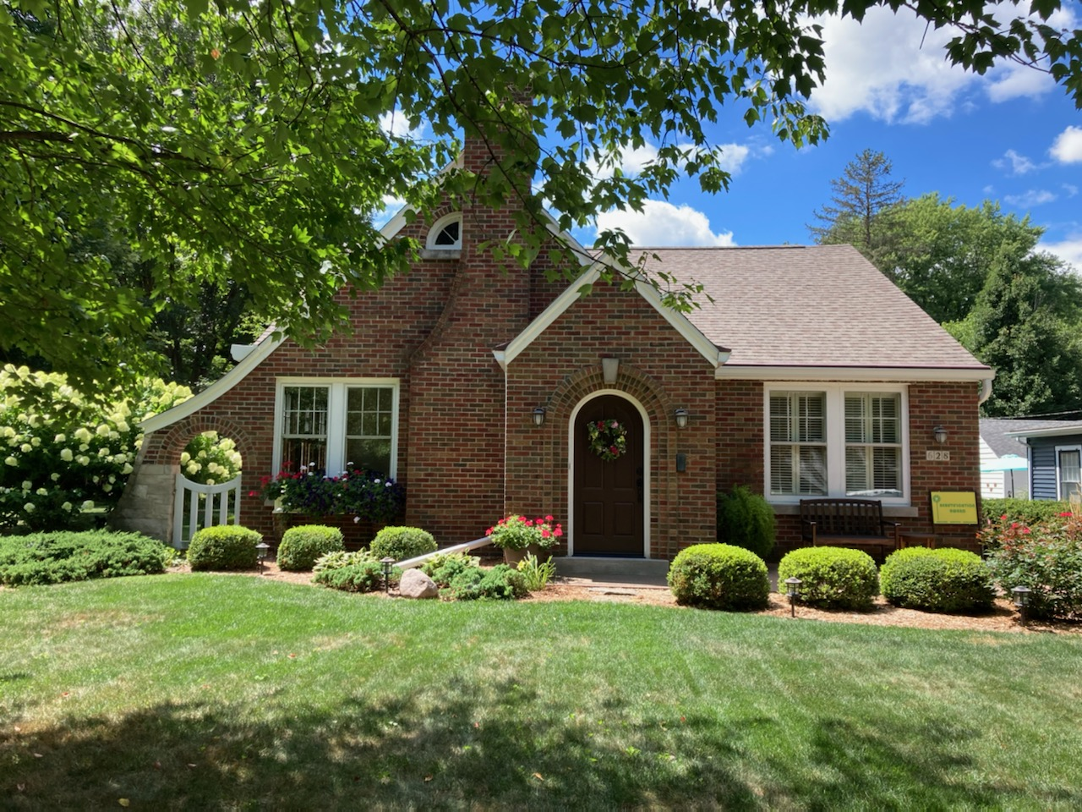

Slide 10
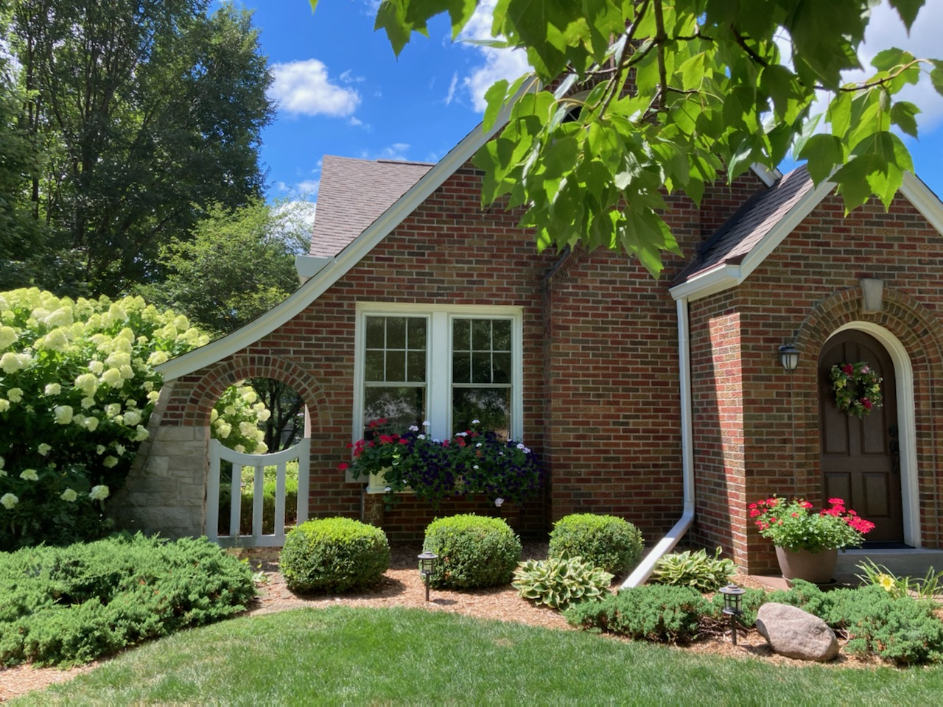

Slide 11
  830 Glenoak Street
Liz and Tyler Hardisty

Slide 12
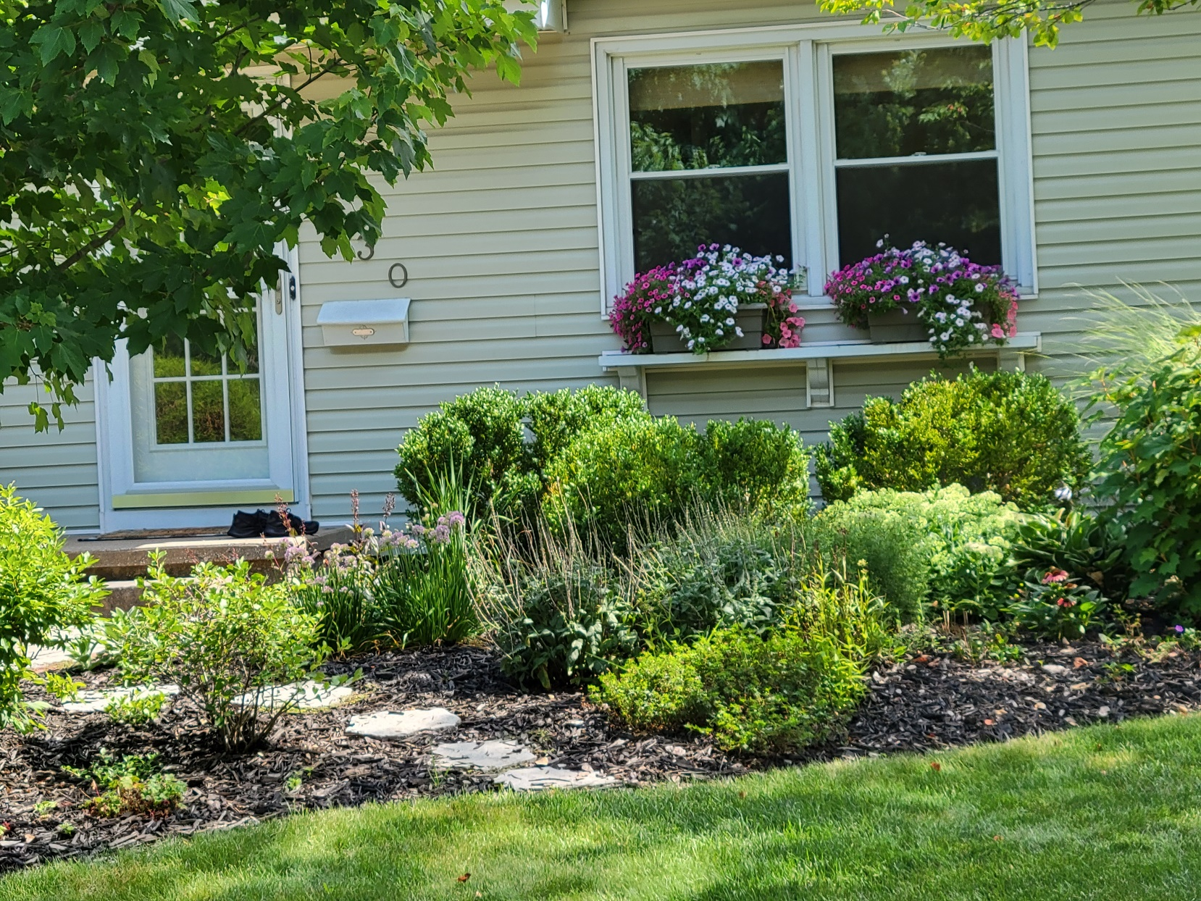

Slide 13
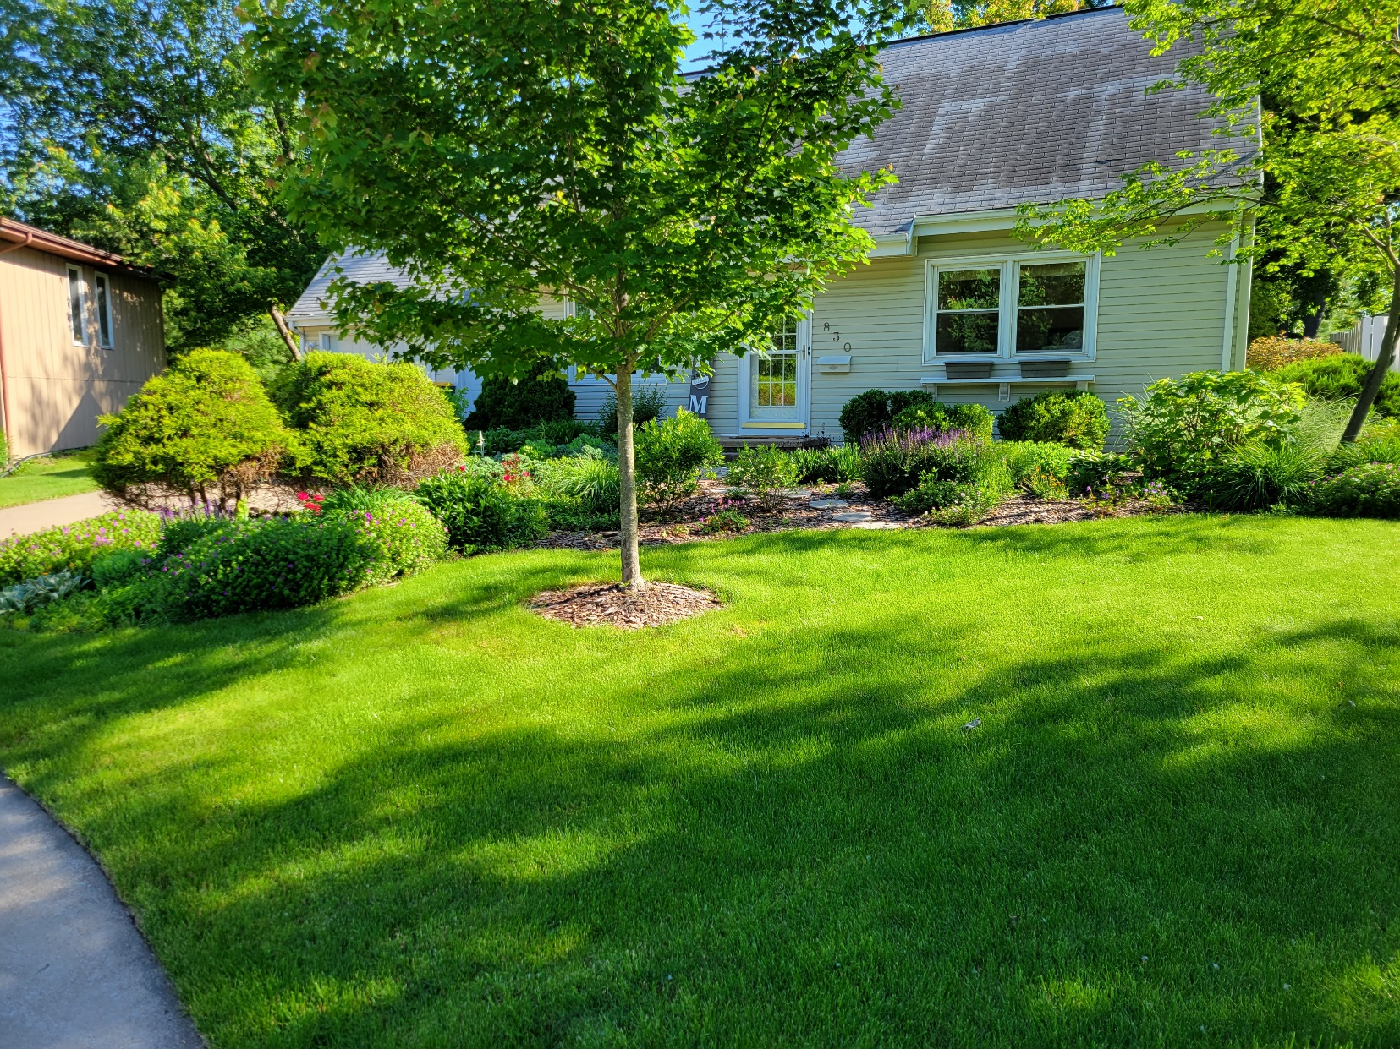

Slide 14
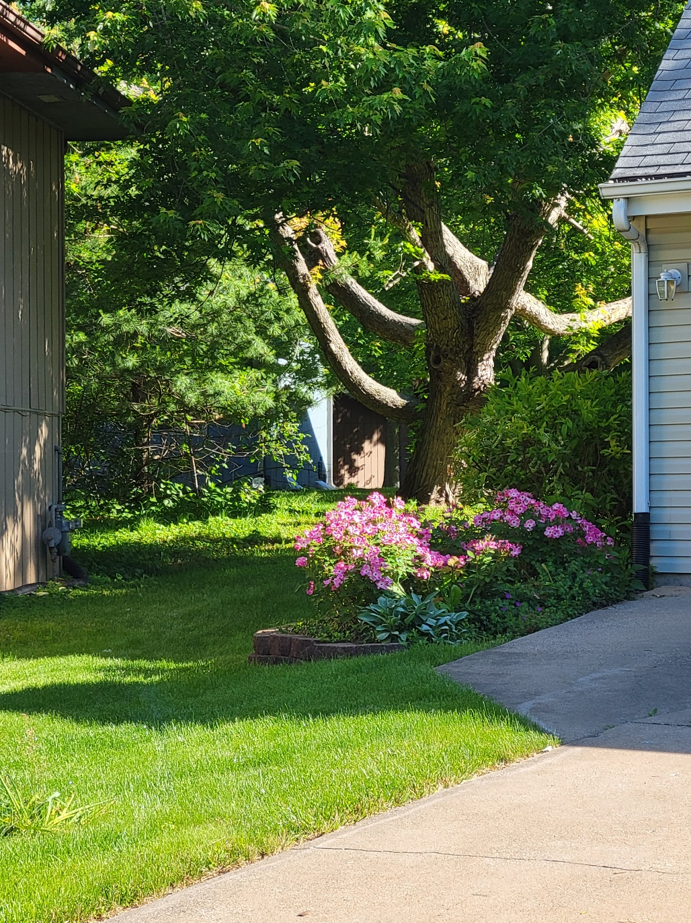

Slide 15
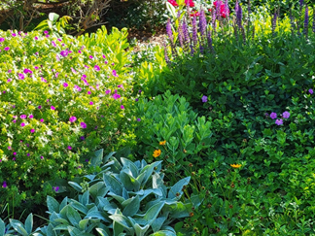

Slide 16
  227 E. Yeiser Street
Bobbi Morrison

Slide 17
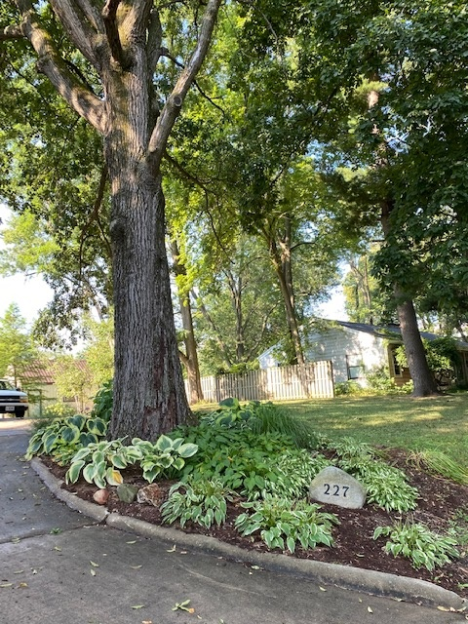

Slide 18
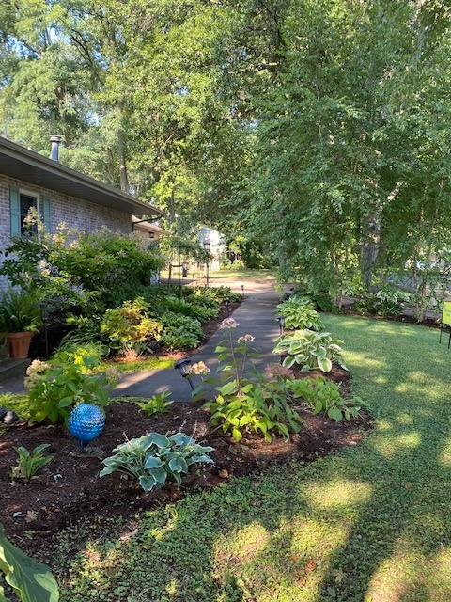

Slide 19
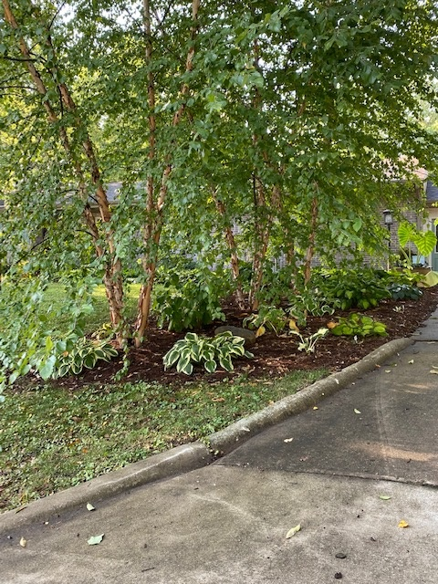

Slide 20
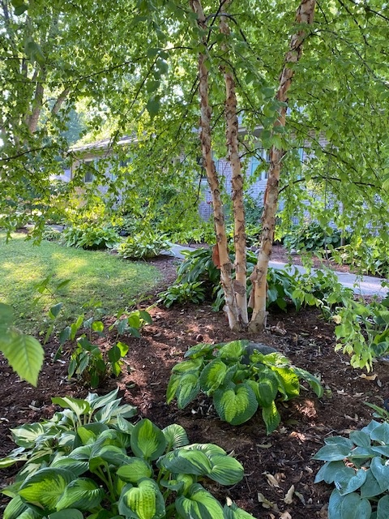

Slide 21
307 Scotch Pine Drive
Bonita Rector

Slide 22
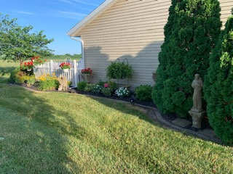

Slide 23
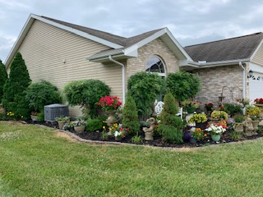

Slide 24
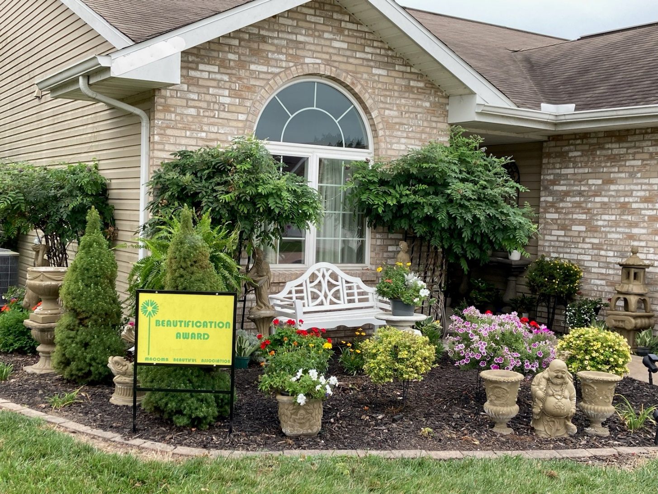

Slide 25
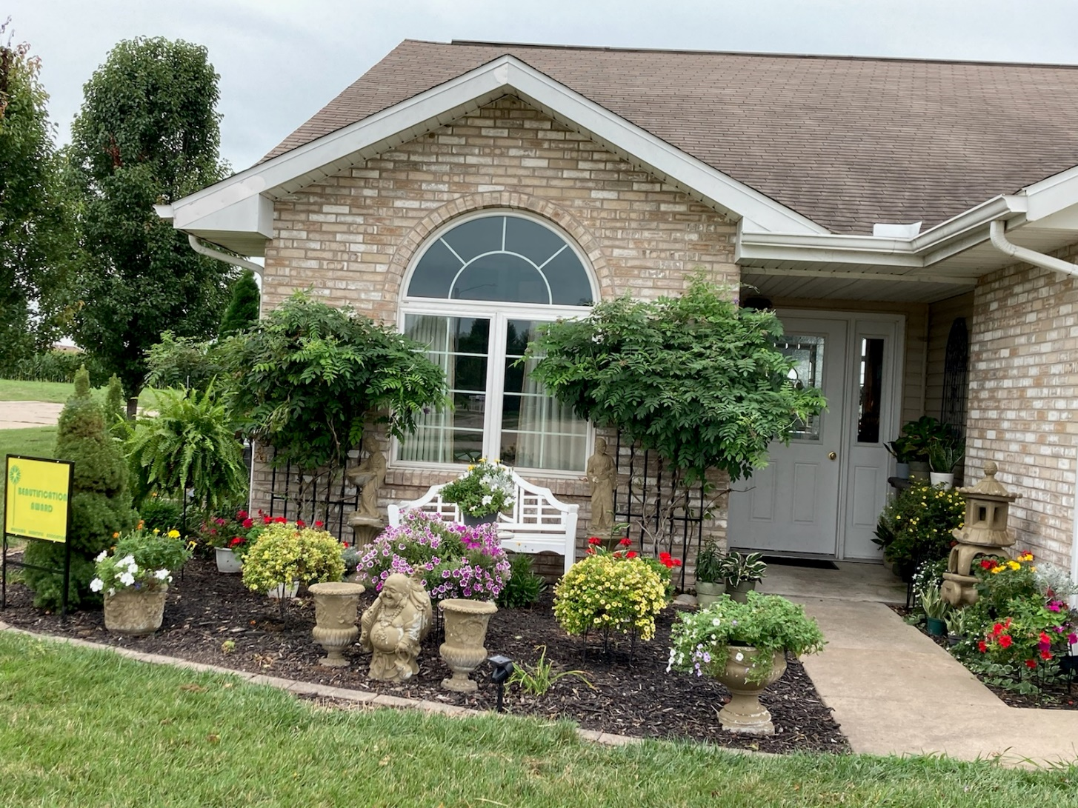

Slide 26
1020 Hawthorne Ridge
Dwaine and Jo Ella Roche

Slide 27
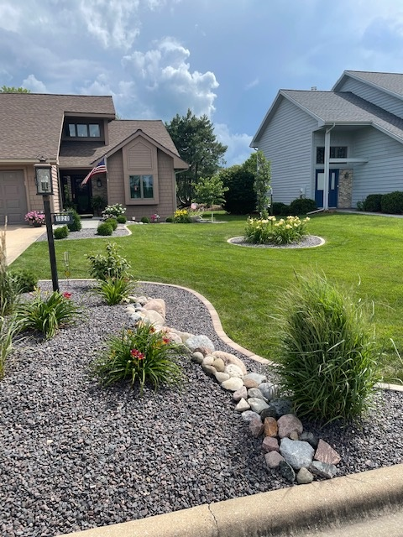

Slide 28
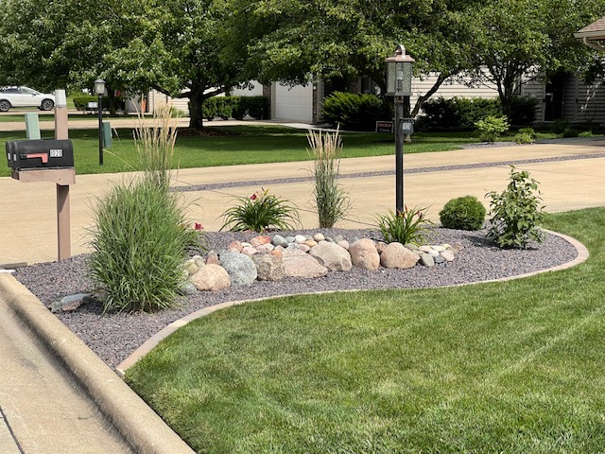

Slide 29
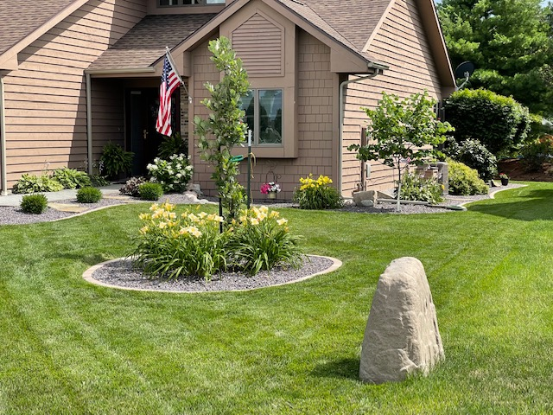

Slide 30
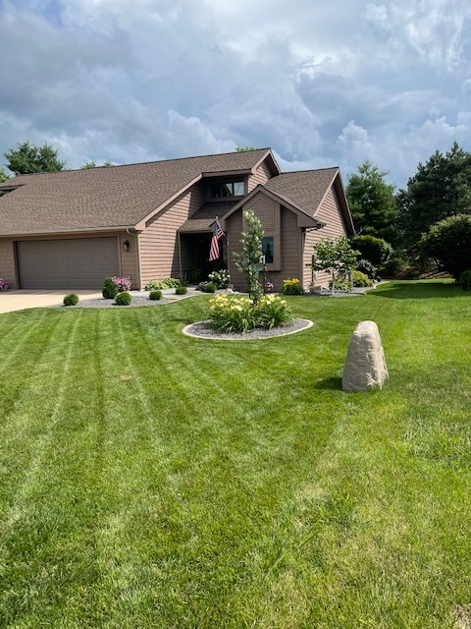

Slide 31
Everly House
811 S. Lafayette
Faith Campbell
Administrator

Slide 32
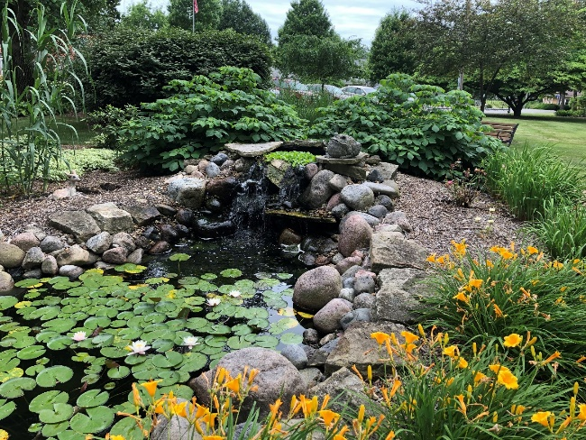

Slide 33
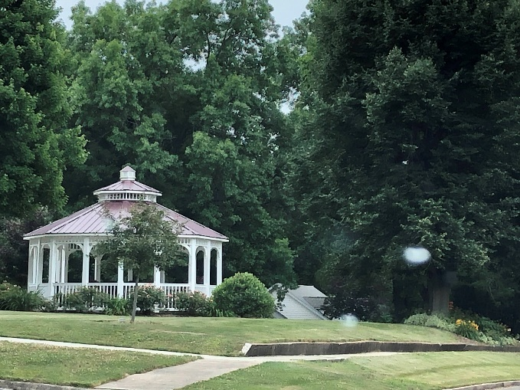

Slide 34
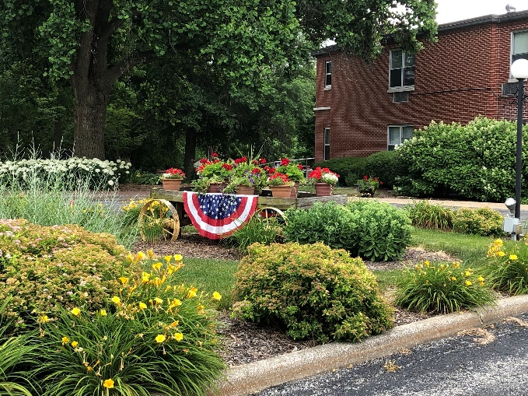

Slide 35
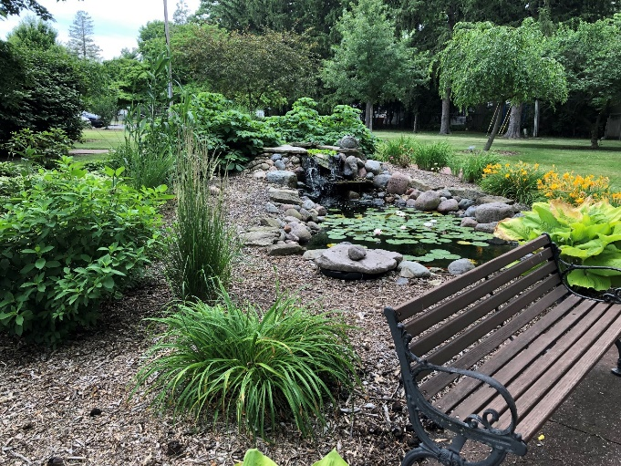

Slide 36
Chubby’s
2 West Side Square
Tammy Yates and Chad Huncyker

Slide 37
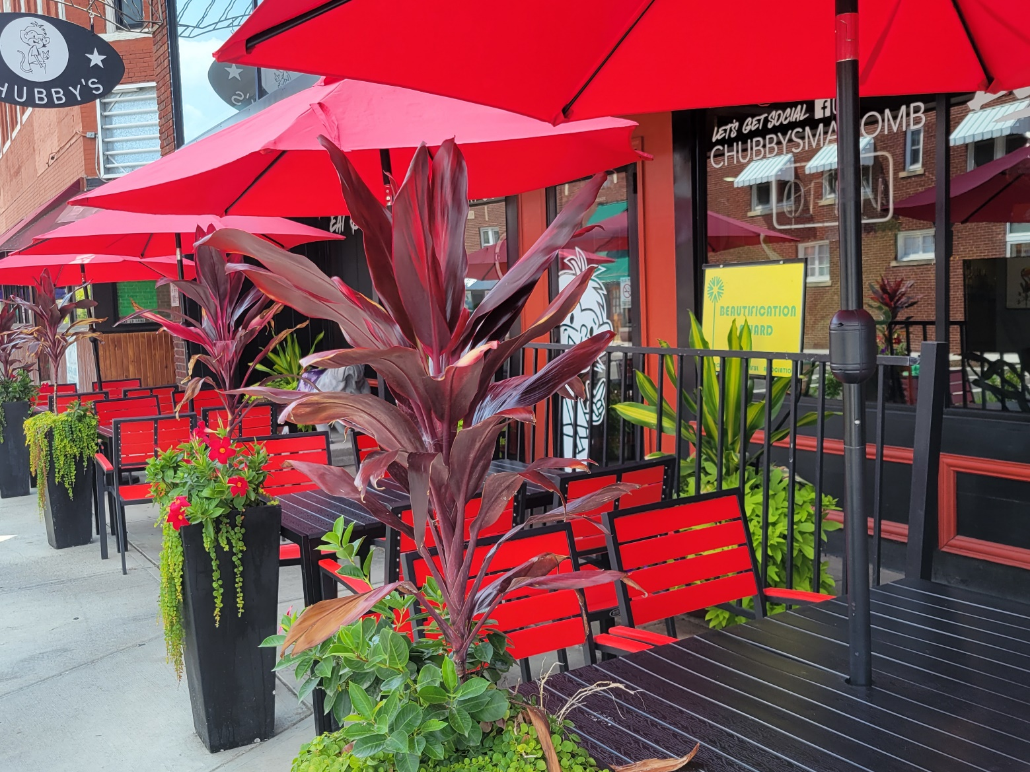

Slide 38
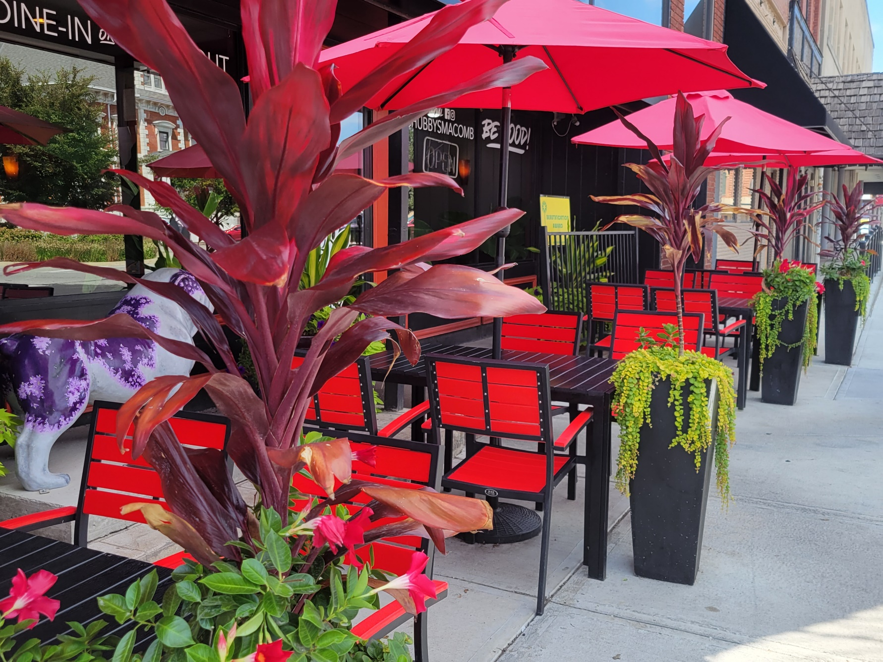

Slide 39
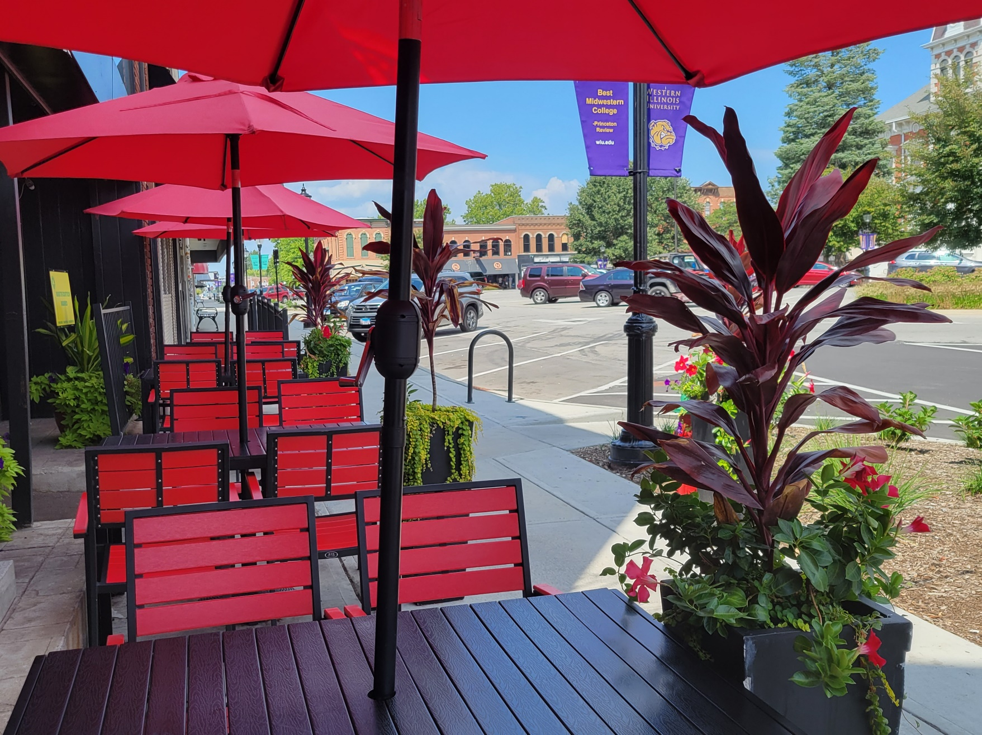

Slide 40
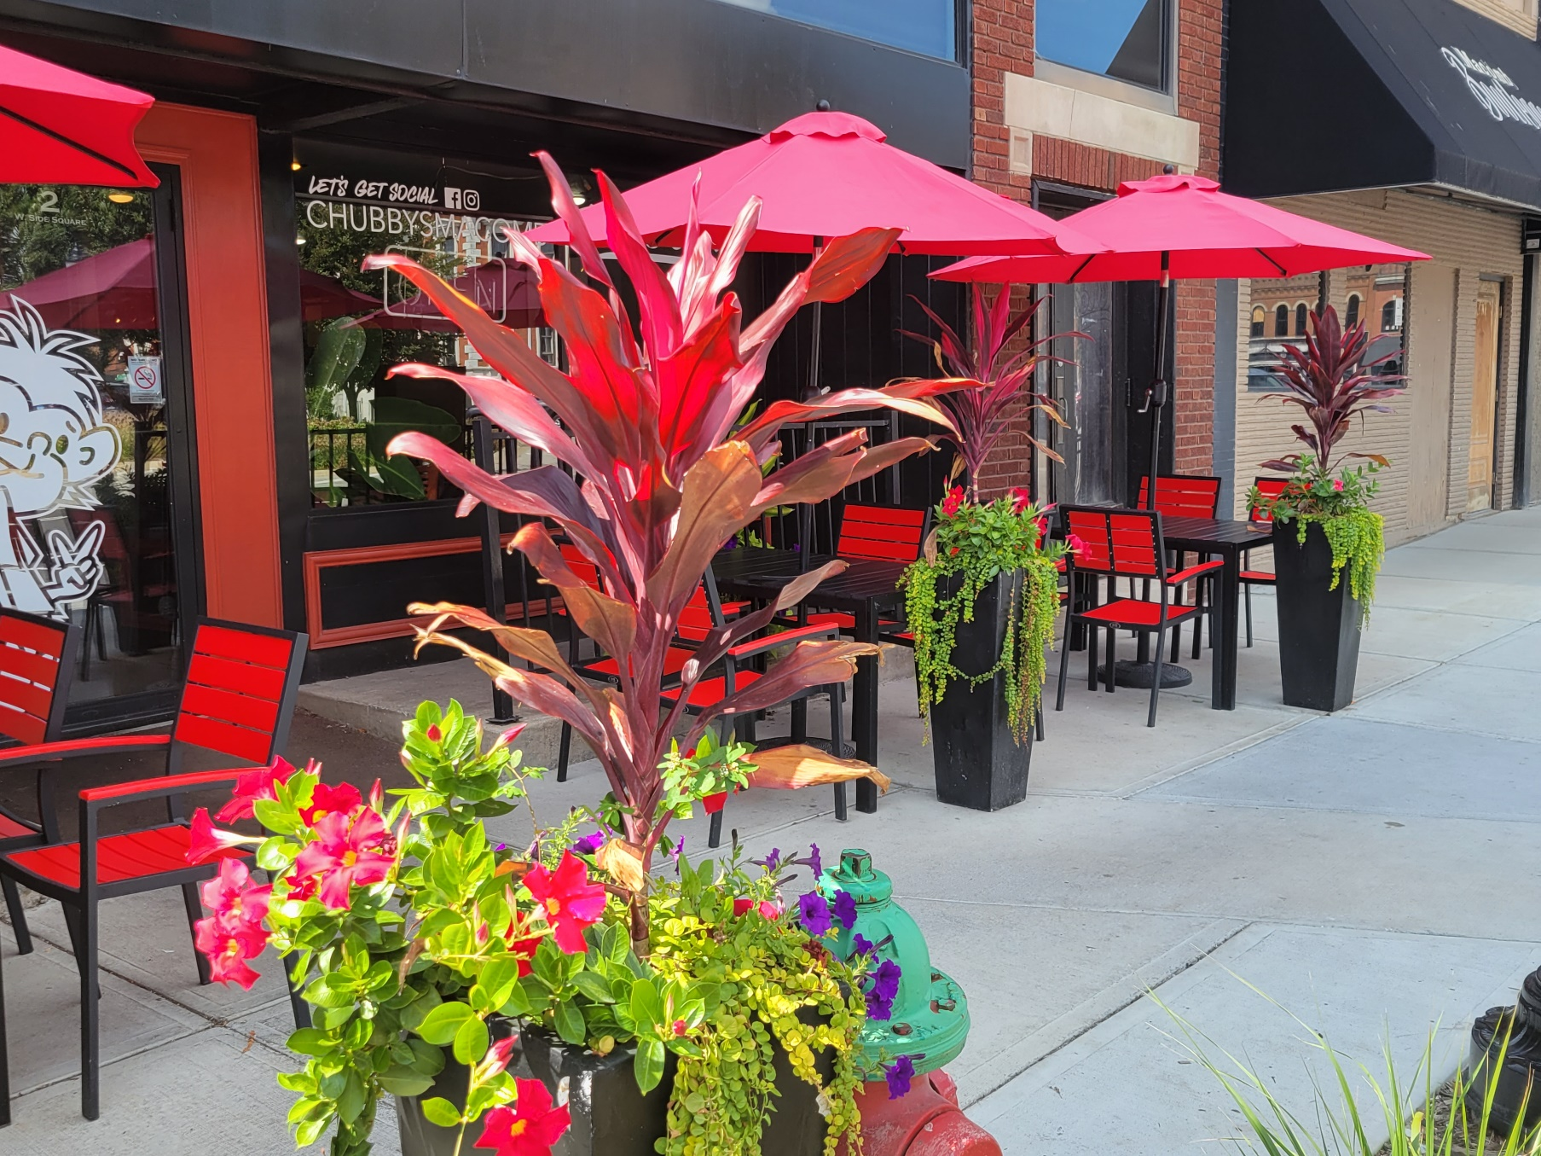

Slide 41
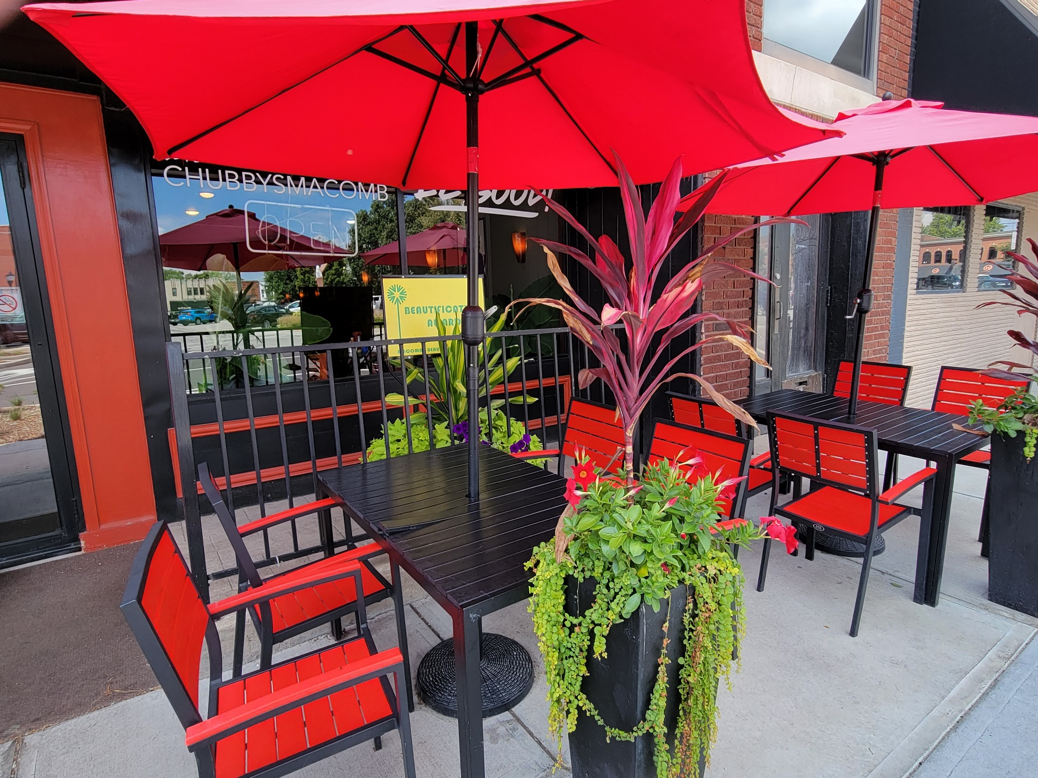

Slide 42
CONGRATULATIONS
TO ALL THE 2022
BEAUTIFICATION AWARD RECIPIENTS

Slide 43
Macomb Beautiful Association
Margaret Stover Service Award

Slide 44
CONGRATULATIONS
Margaret Stover Service Award Winner
Diana and David Pumo

